Slide 1
The Sound and the Fury
by William Faulkner

Slide 2
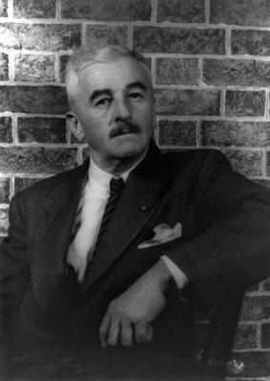
Biography
Born
William Cuthbert Falkner
September 25, 1897(1897-09-25)
New Albany, Mississippi, USA
Died
July 6, 1962 (aged 64)
Byhalia, Mississippi, USA
Occupation
Novelist, short story writer
Genres
Southern Gothic
Literary movement
Modernism, Stream of consciousness
Notable award(s)
Nobel Prize in Literature, 1949
Spouse(s)
Estelle Oldham

Slide 3
Biography
William Faulkner :was a Nobel Prize-winning American author. One of the most influential writers of the 20th century, his reputation is based on his novels, novellas and short stories. He was also a published poet and an occasional screenwriter. Most of Faulkner's works are set in his native state of Mississippi. He is considered one of the most important Southern writers along with Mark Twain. and Tennessee Williams.
Faulkner Unable to join the United States Army because of his height, (he was 5' 5½"), Faulkner first joined the Canadian and then the British Royal Air Force, yet did not see any World War I wartime action.
he was living in New Orleans in 1925 when he wrote his first novel, Soldiers' Pay, after being influenced by Sherwood Anderson to try fiction until his death. In 1959 he suffered serious injuries in a horse-riding accident. Faulkner died of a heart attack at the age of 64.

Slide 4
His Works
Soldier's Pay (1926)
Mosquitoes (1927)
The Sound and the Fury (1929)
Sartoris (1929)
As I Lay Dying (1930)
Short stories
"Mirrors of Chartres Street" (1925)
"Damon and Pythias Unlimited" (1925)
"Mountain Victory" (1932)
"There Was a Queen" (1933)
"Artist at Home" (1933)
Poetry
Vision in Spring (1921)
The Marble Faun (1924)
A Green Bough (1933)
This Earth, a Poem (1932)
Mississippi Poems (1979)
Helen, a Courtship and Mississippi Poems (1981).

Slide 5
The style
The title: The novel’s title is taken from one of the most famous soliloquies in Shakespeare's tragedy Macbeth he says: Tomorrow and tomorrow and tomorrow “And then is heard no more. It is a tale/ Told by an idiot, full of sound and fury,/ Signifying nothing”.
Stream of consciousness: is a technique used by writer’s who want to mimic the way we really experience life. Life is a blend of sensation, memory, emotion.
Faulkner wrote at a time when high modernism was popular. High modernists felt that the traditional method of presenting space and time in the arts didn’t mesh with how we experience life.

Slide 6
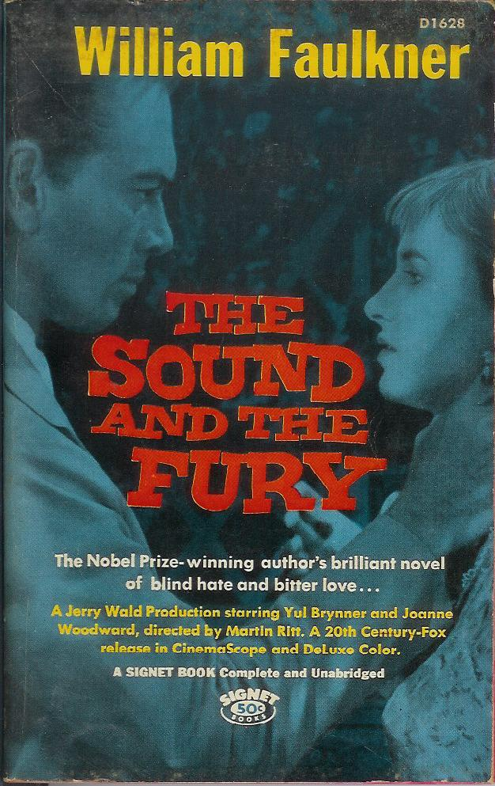
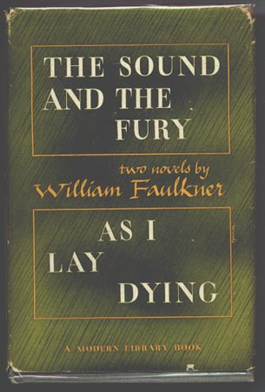

Slide 7
The Sound and the Fury
is a novel written by the American author William Faulkner. It employs a number of narrative styles, including the technique known as stream of consciousness, pioneered by 20th century European novelists such as James Joyce and Virginia Woolf. Published in 1929, The Sound and the Fury was Faulkner's fourth novel, and was not immediately successful. In 1931, however, when Faulkner's fifth novel, Sanctuary, was published — a sensationalist story which Faulkner later claimed was written only for money — The Sound and the Fury also became commercially successful, and Faulkner began to receive critical attention

Slide 8
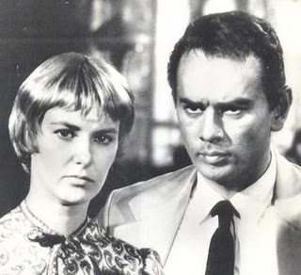

Slide 9
The plot
The novel tells the story, from four different perspectives, of the disintegration of a Southern family. The father is cynical and passive, and though he clearly loves his children, he drinks himself to death; the invalid mother has no love for her children and continuously demands that she herself be taken care of; Benjy, the mentally retarded son of whom his mother is ashamed, is castrated after he begins to exhibit sexual behavior; Quentin, the neurotic and romantic son, goes off to Harvard to fulfill his mother’s lifelong wish and commits suicide there; Caddy, the only daughter, becomes pregnant while still a teenager and quickly marries a man who turns her out of the house when he discovers that their child is not his; Jason, his mother’s favorite, loses his chance at a lucrative job when Caddy’s marriage fails and is reduced to supporting the family by working in a general store

Slide 10
The plot
. Caddy’s daughter—named after her brother Quentin—is brought up in the unhappy Compson household although everyone is forbidden to speak her mother’s name. She has her revenge upon her uncle Jason when she steals the $7000 he has amassed by embezzling from his mother and from funds sent to Quentin by Caddy. The family is supported and cared for by a family of black servants, led and held together by the matriarch Dilsey.

Slide 11
Names:
Nadia khan
Maha Bokhary
Walaa al khale
Malak Halwani
Lujain Bogari

